Slide 1



K.L.E. Society’s Raj-Rajeshwari Arts & Commerce College for Women, Ranebennur Workshop
17-Dec-2022
Presented by Vinayak Goni

Slide 2
Table of contents (TOC) 1. Ice breaker 2. How much negativity do we possess? 3. Story of a Bumble bee 4. Supply Chain Management (SCM) 4. All that matters is attitude 5. Logistic Management 6. Certifications in SCM 7. Building Resume 8. Facing the interview(s) 9. References

Slide 3
Break the shackles

Slide 4

Bumble bee

Slide 5


Slide 6
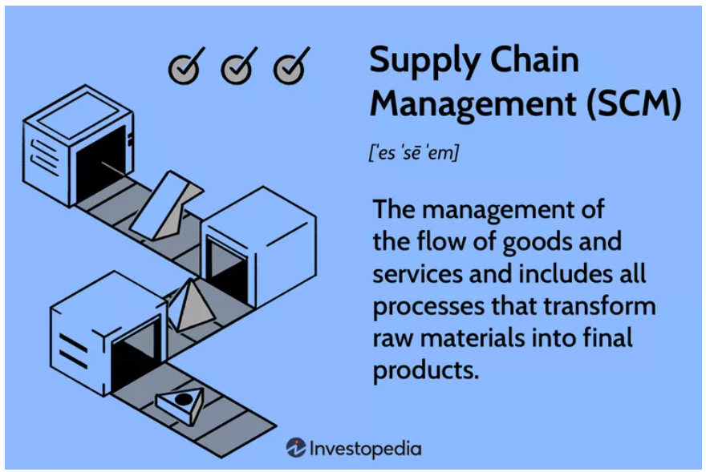
Supply Chain Management (SCM)

Slide 7
SCM contd..
What is Supply Chain Management (SCM)?
Supply chain management is the management of the flow of goods and services and includes all processes that transform raw materials into final products. It involves the active streamlining of a business's supply-side activities to maximize customer value and gain a competitive advantage in the marketplace.
Examples of supply chain activities can include designing, farming, manufacturing, packaging, or transporting.
How Supply Chain Management (SCM) Works
Supply chain management (SCM) represents an effort by suppliers to develop and implement supply chains that are as efficient and economical as possible. Supply chains cover everything from production to product development to the information systems needed to direct these undertakings.

Slide 8
Parts of SCM
Planning
To get the best results from SCM, the process usually begins with planning to match supply with customer and manufacturing demands. Firms must predict what their future needs will be and act accordingly. This relates to raw materials needed during each stage of manufacturing, equipment capacity and limitations, and staffing needs along the SCM process. Large entities often rely on ERP system modules to aggregate information and compile plans.

Slide 9
Sourcing
Efficient SCM processes rely very heavily on strong relationships with suppliers. Sourcing entails working with vendors to supply the raw materials needed throughout the manufacturing process. A company may be able to plan and work with a supplier to source goods in advance. However, different industries will have different sourcing requirements. In general, SCM sourcing includes ensuring:
the raw materials meet the manufacturing specification needed for the production of goods.
the prices paid for the goods are in line with market expectations.
the vendor has the flexibility to deliver emergency materials due to unforeseen events.
the vendor has a proven record of delivering goods on time and in good quality.
Supply chain management is especially critical when manufacturers are working with perishable goods. When sourcing goods, firms should be mindful of lead time and how well a supplier can comply with those needs.

Slide 10
Manufacturing
At the heart of the supply chain management process, the company transforms raw materials by using machinery, labor, or other external forces to make something new. This final product is the ultimate goal of the manufacturing process, though it is not the final stage of supply chain management.
Delivering
Once products are made and sales are finalized, a company must get the products into the hands of its customers. The distribution process is often seen as a brand image contributor, as up until this point, the customer has not yet interacted with the product. In strong SCM processes, a company has robust logistic capabilities and delivery channels to ensure timely, safe, and inexpensive delivery of products.

Slide 11
Returning
The supply chain management process concludes with support for the product and customer returns. Its bad enough that a customer needs to return a product, and its even worse if its due to an error on the company's part. This return process is often called reverse logistics, and the company must ensure it has the capabilities to receive returned products and correctly assign refunds for returns received. Whether a company is performing a product recall or a customer is simply not satisfied with the product, the transaction with the customer must be remedied.

Slide 12
Activity on SCM

Slide 13
KEY TAKEAWAYS
Supply chain management (SCM) is the centralized management of the flow of goods and services and includes all processes that transform raw materials into final products.
By managing the supply chain, companies can cut excess costs and deliver products to the consumer faster and more efficiently.
Good supply chain management keeps companies out of the headlines and away from expensive recalls and lawsuits.
The five most critical elements of SCM are developing a strategy, sourcing raw materials, production, distribution, and returns.
A supply chain manager is tasked with controlling and reducing costs and avoiding supply shortages.

Slide 14


Slide 15


Slide 16


Slide 17
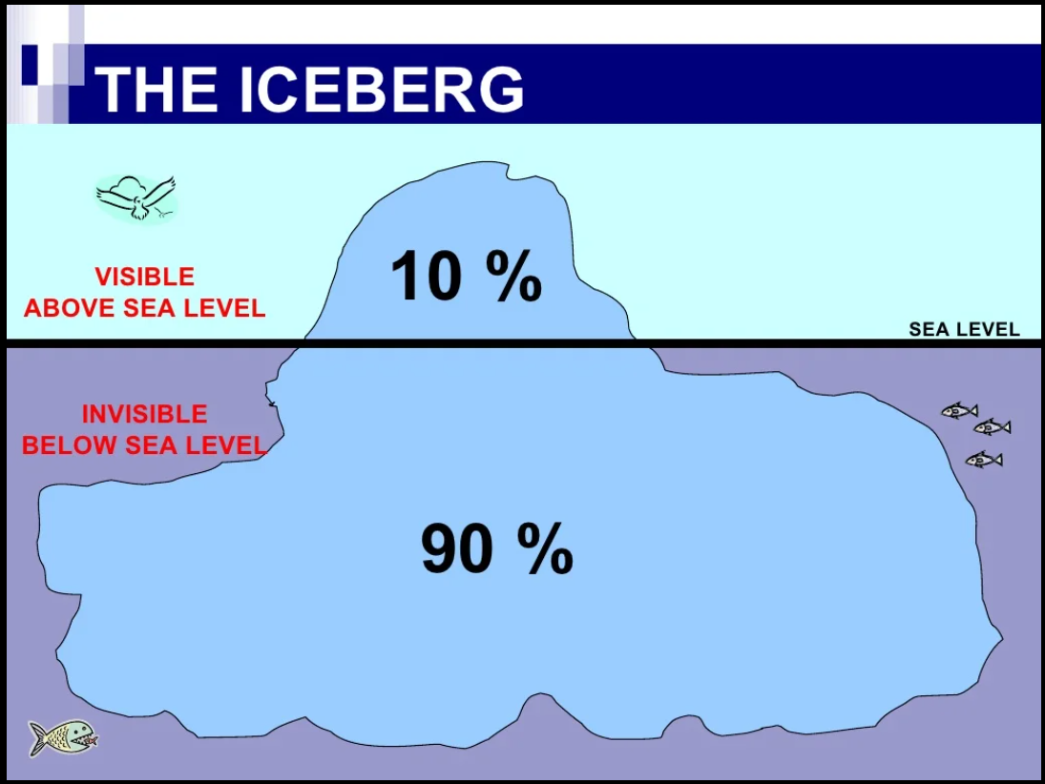

Slide 18


Slide 19
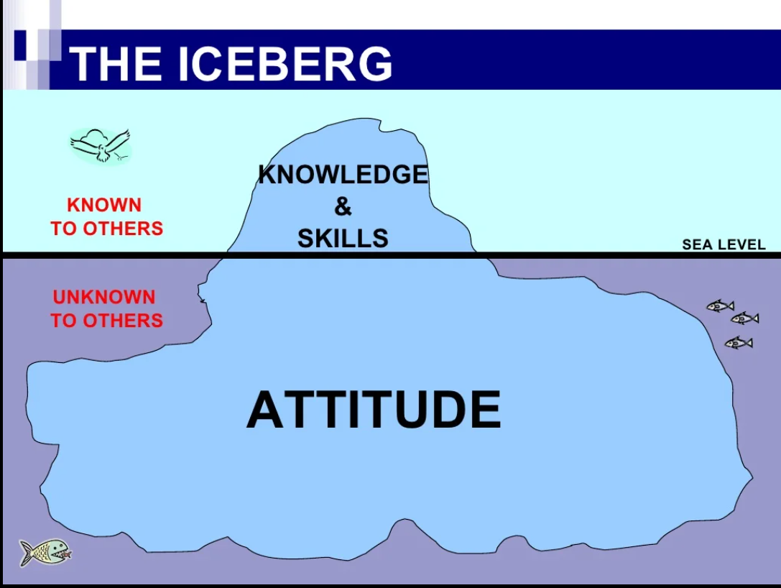

Slide 20
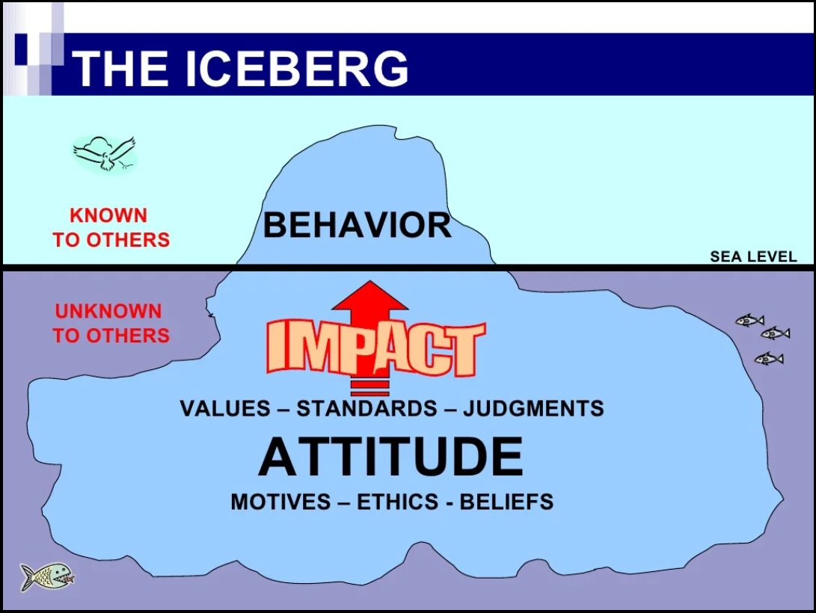

Slide 21
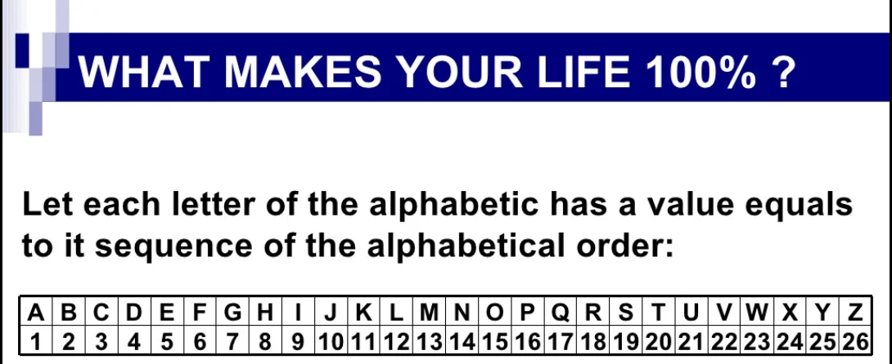

Slide 22
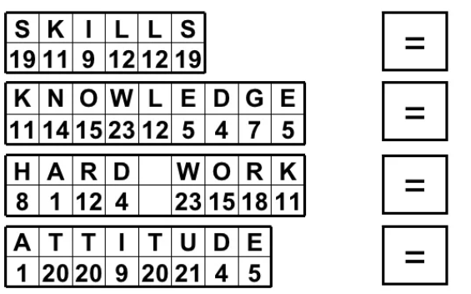

Slide 23
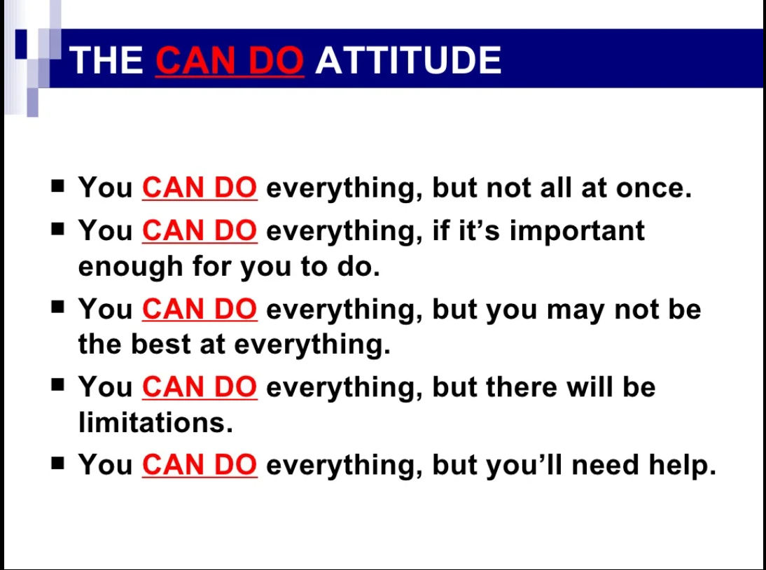

Slide 24
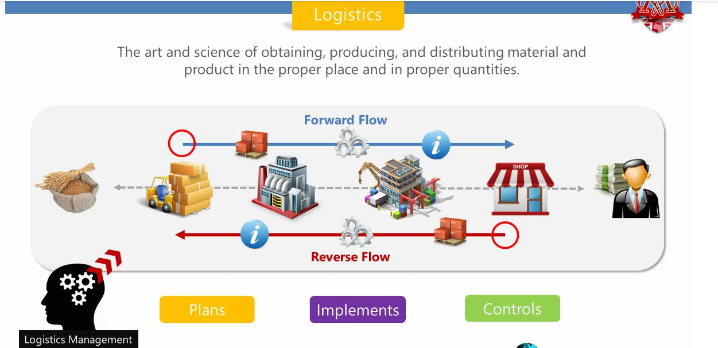
Logistic Management in SCM

Slide 25
Logistics management is the governance of supply chain management functions that helps organizations plan, manage and implement processes to move and store goods.
Logistics management activities typically include inbound and outbound transportation management, fleet management, warehousing, materials handling, order fulfillment, logistics network design, inventory control, supply/demand planning and management of third-party logistics services providers.

Slide 26
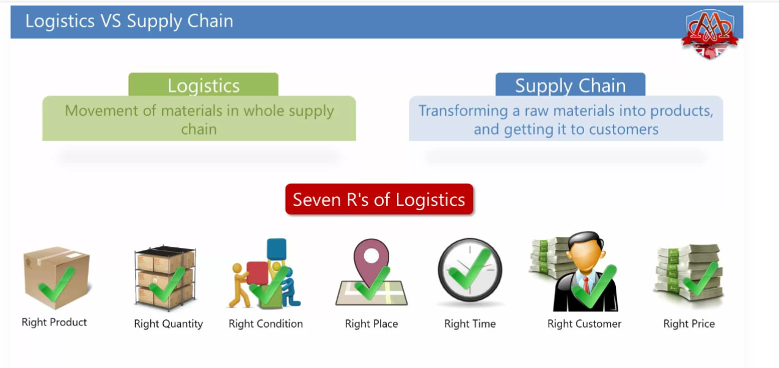

Slide 27
Real time example for a logistic management:
The Dabbawala community has about 5000 people working with them.
These Dabbawalas deliver lunch boxes for about 2 lakh people at their
work places on time. work doesn’t end here.
They also carry the empty lunch boxes back to the homes of the customers.
The unbelievable part is they make only one mistake in sixteen million transactions
and have been consistently good at it for all the time of their operations.
This credibility earned them a six sigma designation by the Forbes magazine
and ISO 9001 accreditation.

Slide 28
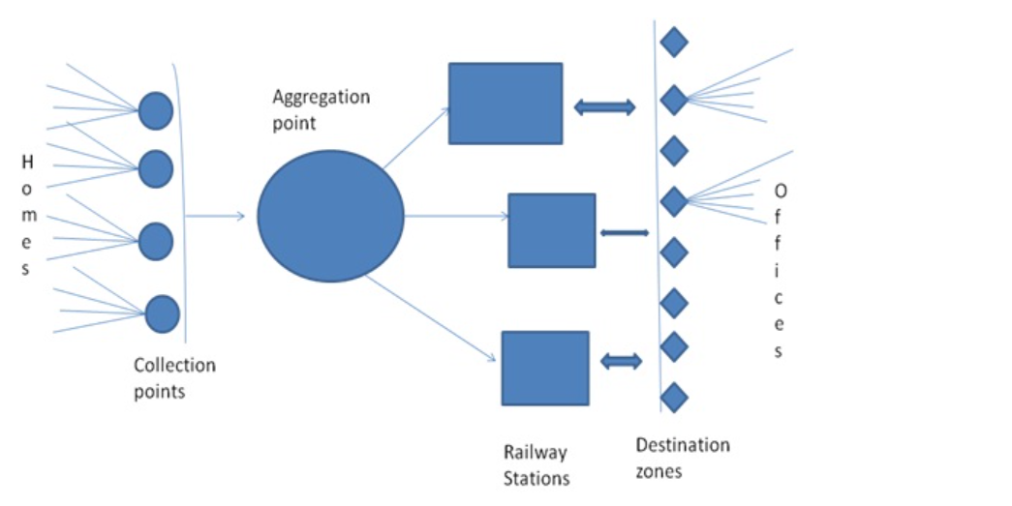

Slide 29
Certifications in SCM
Top 12 SCM certifications
ASCM Certified in Logistics, Transportation, and Distribution (CLTD)
ASCM Certified in Production and Inventory Management (CPIM)
ASCM Certified Supply Chain Professional certification (CSCP)
ASCM Supply Chain Operations Reference (SCOR-P) Endorsement
Certified Six Sigma Black Belt
ISM Certified Professional in Supply Management (CPSM)
ISM Certified Professional in Supplier Diversity (CPSD)
NCMA Certified Professional Contract Manager (CPCM)
Oracle E-Business Suite 12 Supply Chain Certified Implementation Specialist: Oracle Purchasing Certification
SCPro Council of Supply Chain Management Fundamentals
SCPro Council of Supply Chain Management Professionals (CSCMP)
SOLE Certified Professional Logistician (CPL)

Slide 30
Building a Resume

Slide 31
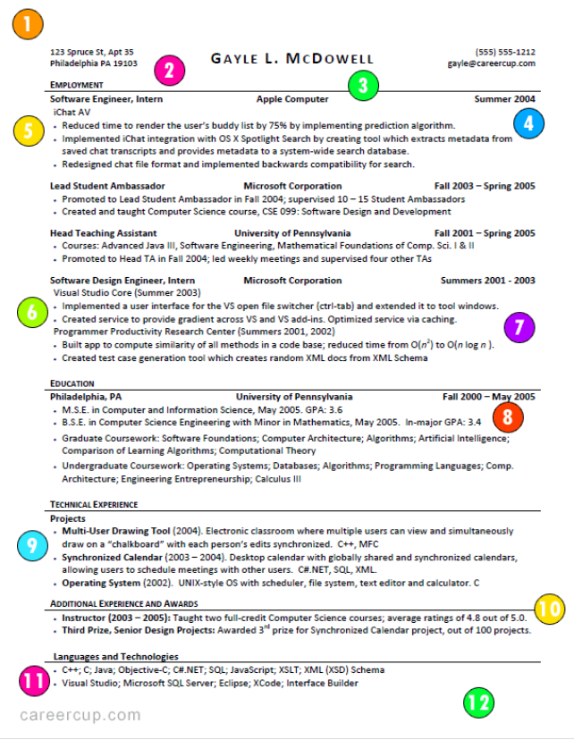

Slide 32
Few websites to your rescue
1. Career cup
https://www.careercup.com/resume
2. Zetty
https://zety.com/
3. Nova
https://novoresume.com/

Slide 33
How to face the interview(s)

Slide 34
Few websites to your rescue
1. Linkedin
https://linkedin.com/
2. Naukri
https://www.naukri.com/

Slide 35
Story of a Man with only hand

Slide 36


Slide 37
References and Credits 1. Google 2. YouTube 3. Mahatria AKA T T Rangarajan 4. Gururaj Karjagi 5. Sandeep Maheshwari 6. Puzzles to puzzle you – By Shakuntaladevi

Slide 38
I am reachable here
linkedin.com/in/vinayak-goni
Email: vinayakgbiet@gmail.com
Phone: +91-7795640413

Slide 39


Slide 40
THANK YOU…..

